Slide 1




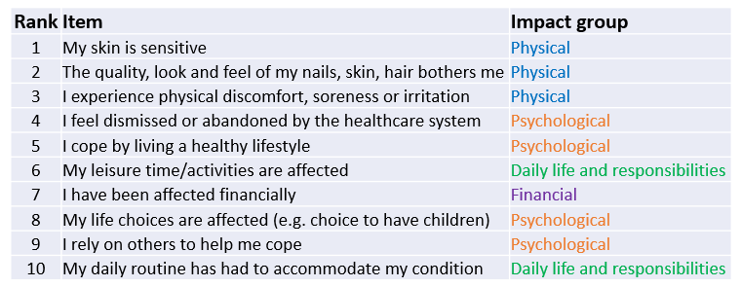

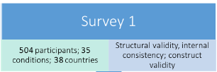
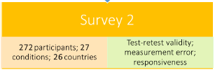
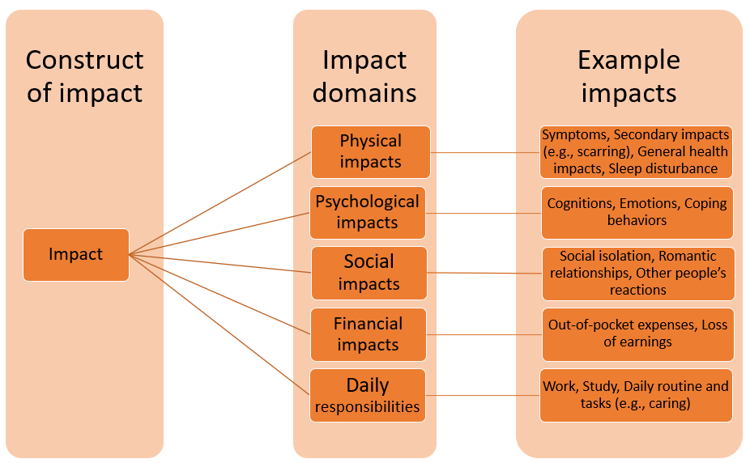
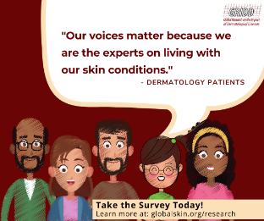
Patient-Reported Impact of Dermatological Diseases (PRIDD): Patient-centred Development and validation of the PRIDD Measure
Allison FitzGerald¹,Rachael Pattinson², Nirohshah Trialonis-Suthakharan³, Jennifer Austin^{1,} Matthias Augustin³ and Chris Bundy²
¹International Alliance of Dermatology Patient Organizations, Ottawa, Canada. ²School of Dentistry, Cardiff University, Cardiff, United Kingdom. ³Institute for Health Services Research in Dermatology and Nursing, University Medical Center Hamburg-Eppendorf, Hamburg, Germany.
GRIDD
PRIDD Results II
Patient Engagement
The Global Research on the Impact of Dermatological Diseases (GRIDD) project is developing the Patient-Reported Impact of Dermatological Diseases (PRIDD), a new measure of the impact of dermatological conditions on the patient’s life.
Overall, 27 impact items were included in PRIDD.
The list of the top 10 impacts represent which research questions and initiatives were most important to patients.
Phase 2
Phase 3
Item Gathering: 2019-2020
Workshop: 37 patients in 16 countries and 14 diseases
Patient interviews: 28 patients in 11 countries and 5 diseases
Delphi Surveys: 2020-2021
1154 patients in 61 countries and 90 diseases
Cognitive Interviews: 2021
12 patients in 4 countries and 6 diseases
Survey #1: 486 patients (Completed Dec. 2021)
Psychometrics Surveys: 2021-2022
Survey #2: Test - 504 patients completed July 2022; re-test – 272+ patients (Completed Sept. 2022)
Outcome: 263 items
Outcome: 27 items
Outcome: 26 items
Outcome - 16 items FINAL MEASURE
Two Delphi rounds
Six languages
Quantitative data Qualitative data
Patient Inclusion in GRIDD: 2490+ patients
Phase 3
PRIDD
Target population
Adults (≥ 18 years) worldwide living with a dermatological condition
Target construct
Impact of dermatological conditions on the patient’s life
Application
Research and clinical practice
Phase 4
Phase 4
Phase 1
Phase 4
We created a 26-item version of PRIDD with evidence of content validity, feasibility, and acceptability from patients. Overall, patients were happy with PRIDD and we made some minor adjustments based on their feedback.
None of the existing dermatology PROMs met the scientific standards.
Cognitive interviews
Translate: The PRIDD tool is translated into 16 languages.
Launch: GRIDD Study to collect global data online across derm diseases.
Promote: PRIDD measure globally for research and clinical use.
GRIDD Study
Phase 4
Psychometric testing
Phase 5
PRIDD Results I
PROM​ | CONTENT VALIDITY​ | STRUCTURAL VALIDITY​ | INTERNAL CONSISTENCY​ | RELIABILITY​ | MEASUREMENT ERROR​ | CONSTRUCT VALIDITY​ | RESPONSIVENESS​ | RECOMMEND-ATION​
DLQI​ | W​ | ???​ | +++​ | ?​ | ​ | +++​ | +++​ | B​
PRIDD​ | ​++ | +++ ​ | ​+++ | +++ ​ | ​? | ​+++ | ? ​ | A​
Skindex​ | W​ | ???​ | W​ | W​ | ​ | -​ | W​ | B​
Skindex 29 | W​ | ???​ | +++​ | W​ | ​ | +++​ | W​ | B​
Skindex 16​ | W​ | ++​ | ++​ | ​ | ​ | +​ | W​ | B​
263 unique shared impacts of dermatological conditions were found, falling into five broad groups: physical, psychological, social, financial, and daily life and responsibilities impacts. We started drafting PRIDD using these 263 impacts and the conceptual framework shown here.
Phase 2
January-March 2023 June-December 2023 2024+
Qualitative Patient Interview studies
Who: 10,000 adult participants globally living with dermatological conditions and diseases
What: Online Survey taking approx. 15-20 min to complete
- Questions about patient and several measures (DLQI, WHO-5,EQ-5D etc.)
- PRIDD measures the impact of the participants’ conditions over the last month
263 shared impacts
W = weak evidence; + = sufficient evidence; - = insufficient evidence; ? = indeterminate evidence
A= Recommended for use
B=Potential to be recommended for use, but they require further research
C= Should not be recommended for use
Contact: allison.fitzgerald@globalskin.org https://globalskin.org/research

