Slide 1

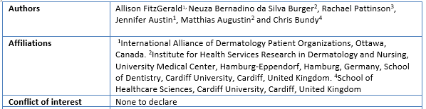



Development of the Patient-Reported Impact of Dermatological Diseases (PRIDD) measure

Slide 2
GRIDD Scientific Advisory Board
Prof. Ramesha M. Bhat - Father Muller Medical College (India)
Prof. Arnon D. Cohen - Clalit Health Services (Israel)
Prof. Ncoza Dlova - Nelson R Mandela School of Medicine (South Africa)
Dr. Toshiya Ebata - The Jikei University School of Medicine (Japan)
Dr. Cristina Echeverría - ECHO Psoriasis Argentina
Prof. Andrew Finlay - Cardiff University (UK)
Dr. Alice Gottlieb - Icahn School of Medicine at Mt Sinai (US)
Dr. Luigi Naldi - University Pavia (Italy)
Dr. Lone Skov - University of Copenhagen (Denmark)
Marc Yale - International Pemphigus Pemphigoid Foundation (US)
Notes:
Marc-
We truly appreciate all the insights and advice the Scientific Advisory board has been able to provide.
We have been privileged to work with an international group of experts including Professor Andrew Finlay, the creator of the DLQI.

Slide 3
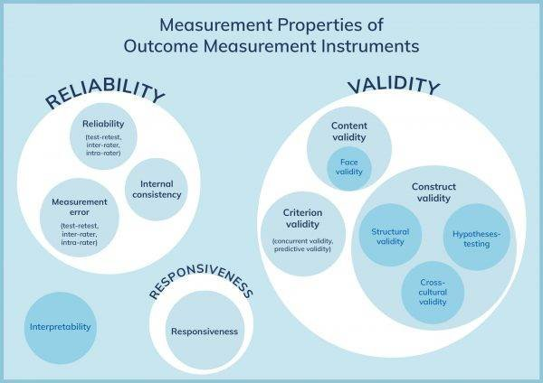




Testing PRIDD's measurement properties
Phase 4
Notes:
Rachael
Any measure, whether it's weighing scale or patient-reported outcome measure, needs to demonstrate that it meets certain criteria before it can be used by clinicians, researchers or regulators like the FDA.
These criteria are called measurement properties. There are many of them and they fall into three groups. Reliability is about the stability of a measure (if you get the same results over time when nothing has changed), validity is the degree to which a measure actually measures what it aims to (for example, bathroom scales are not a valid measure of fat loss, because they measure the whole person, not just fat), and responsiveness is the degree to which a measure can detect change over time, for example, before and after starting a new treatment.
We used a standardised framework called COSMIN to test PRIDD's measurement properties.

Slide 4

Patient Inclusion in GRIDD: 5600+ patients
Item Gathering: 2019-2020
Workshop: 37 patients in 16 countries and 14 diseases
Patient interviews: 28 patients in 11 countries and 5 diseases
Delphi Surveys: 2020-2021
1154 patients in 61 countries and 90 diseases (241 psoriasis patients)
Cognitive Interviews: 2021
12 patients in 4 countries and 6 diseases (2 psoriasis patients)
Survey #1: 486 patients (Completed Dec. 2021)
Psychometrics Surveys: 2021-2022
Survey #2: Test - 504 patients completed July 2022; re-test – 272 patients (Completed Sept. 2022)
Outcome: 263 items
Outcome: 27 items
Outcome: 26 items
Outcome: 16 items
GRIDD Study: 2023 used the 16 question PRIDD measure for the first time
Survey #1: 3800+ patients (Closed Dec 31, 2023) (473 psoriasis patients)
Survey #2: Re-test 1230+ patients (Closed Dec 31,2023)
Phase 2
Phase 3
Phase 4
Phase 4
Phase 5
Notes:
Jennifer:

Slide 5
Psychometric testing – PRIDD results
 |  | Requirement | Rating | Results
Structural validity | Unidimensionality | - No violation of unidimensionality - No violation of local independence - Adequate model fit: χ² >0.01 | + | PRIDD and all subscales unidimensional with no local dependency. χ² = 0.11
 | Structural validity | CFI or TLI or comparable measure > 0.95 OR RMSEA < 0.06 OR SRMR < 0.08 | + | CFI = 0.96; TLI = 0.97; RMSEA = 0.09; SRMR = 0.03
Internal consistency |  | Person Separation Index ≥ 0.7 | + | Person Separation Index = 0.89
Hypothesis testing for construct validity |  | 75% of hypotheses met | + | 76% of hypotheses met
Test-retest reliability |  | ICC or weighted Kappa ≥ 0.70 | + | ICC = 0.93
Measurement error |  | SDC or LoA < MIC | + | LoA (1.3) < MIC (4.14) Unable to determine anchor-based MIC
Responsiveness |  | The result is in accordance with the hypothesis OR AUC ≥ 0.70 | - | 0 hypotheses met
Floor & ceiling effects |  | Considered present when > 15% of the patients achieved the minimum or maximum possible score | + | < 0.9% with minimum or maximum score
MIC |  | N/A |  | Unable to determine anchor-based MIC
“+” = sufficient, ” –“ = insufficient, “?” = indeterminate CFI: Comparative Fit Index; TLI ; Tucker-Lewis Index; RMSEA: Root Mean Square Error of Approximation; SRMR: Standardised Root Mean Square; ICC: Intraclass Correlation Coefficient; SDC: Smallest Detectable Change; LoA: Limits of Agreement; MIC: Minimally Important Change
W = weak evidence; + = sufficient evidence; - = insufficient evidence; ? = indeterminate evidence
A= Recommended for use
B-Potential to be recommended for use, but they require further research
C= Should not be recommended for use

Slide 6
Psychometric testing: Comparison of Measures
PROM​ | Content validity​ | Structural validity​ | Internal consistency​ | Reliability​ | Measurement error​ | Construct validity​ | Responsiveness​ | Recommendation​
DLQI​ | W​ | ???​ | +++​ | ?​ | ​ | +++​ | +++​ | B​
PRIDD​ | ​++ | +++ ​ | ​+++ | +++ ​ | ​? | ​+++ | ? ​ | A​
Skindex​ | W​ | ???​ | W​ | W​ | ​ | -​ | W​ | B​
Skindex 29 | W​ | ???​ | +++​ | W​ | ​ | +++​ | W​ | B​
Skindex 16​ | W​ | ++​ | ++​ | ​ | ​ | +​ | W​ | B​
W = weak evidence; + = sufficient evidence; - = insufficient evidence; ? = indeterminate evidence
A= Recommended for use
B-Potential to be recommended for use, but they require further research
C= Should not be recommended for use
Notes:
Rachael
An overview of the measurement properties of PRIDD and the most commonly used dermatology patient-reported measures – the DLQI and the Skindex Instruments
Nearly all of PRIDD's measurement properties meet the criteria. We are retesting the indeterminate ones during the GRIDD study.
PRIDD is the only dermatology PROM that scored 'A' - that means it’s the only one that meets the criteria to be recommended for use.

Slide 7
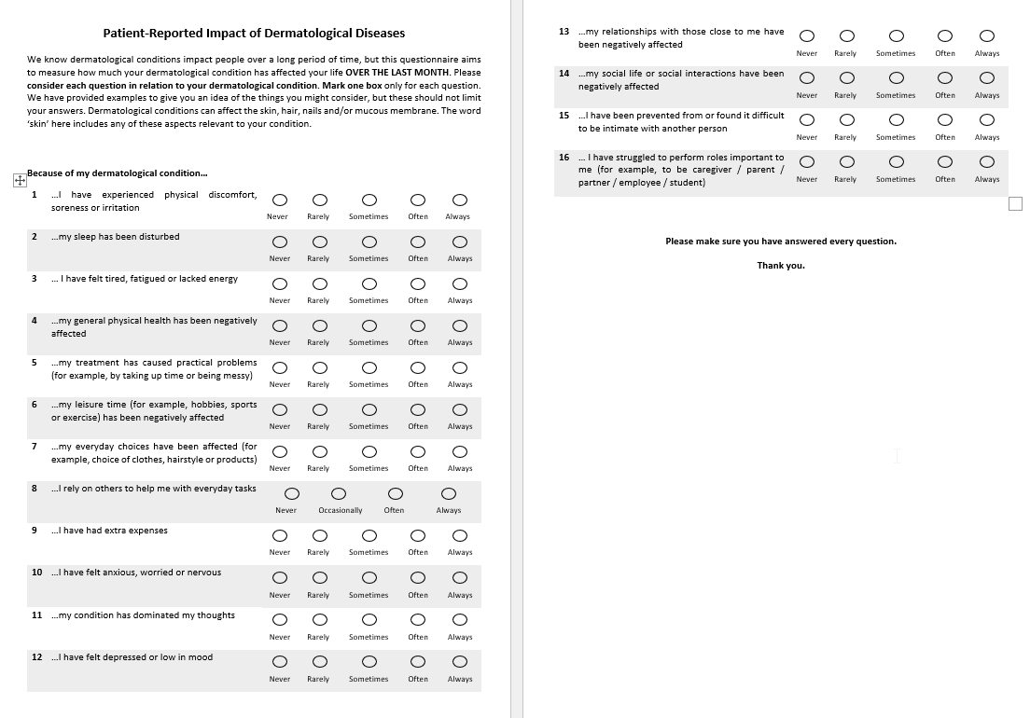
Final version & preview of PRIDD©
Phase 4
PRIDD asks questions in 4 domains:
Physical
Life Responsibilities
Psychological
Social
Notes:
Rachael
Unveil
Easy to use in clinic

Slide 8
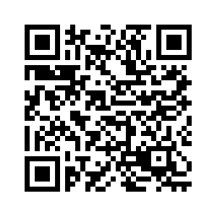




Read our GRIDD Journal Articles!
1. Field Testing of PRIDD – December 2023
2. Measurement and Interpretability of PRIDD
- June 2024
Patient‐Reported Impact of Dermatological Diseases measure: A Global Delphi Study – February 2024
Notes:
Jennifer

Slide 9
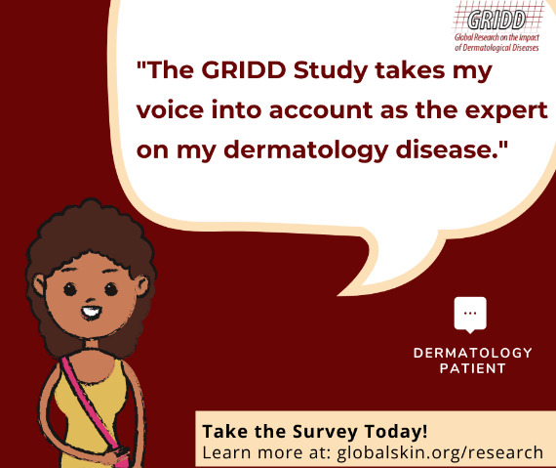
GRIDD Study: What was included?
Phase 5
Demographic questions
Questions about dermatological condition
Questions about healthcare
Patient-reported measures:
  PRIDD – impact of dermatological conditions
  EQ-5D – generic quality of life
  WHO-5 – mental wellbeing
  Patient Health Questionnaire (PHQ9) - depression
  General Anxiety Disorder (GAD7) - anxiety
  Dermatology Life Quality Index (DLQI) - dermatology quality of life
Notes:
Rachael
I want to explain why each of the questions in the survey have been included.
When developing a survey, researchers are always find a balance between maximising the amount of information we can obtain while ensuring that the survey isn't too burdensome for patients.
In the GRIDD study, we are trying to do two things: understand the impact of dermatological conditions and validate the cross-cultural translations of PRIDD. PRIDD is key to both of these.
In addition, we also need to know demographic information about the participants, their conditions, their experiences with healthcare and things related to impact. To illustrate, it would be beneficial to know, for example, if any particular age groups are especially impacted by their condition, whether the body area affected influences the levels of impact, and what effect effective medication has on impact. We can assess this by asking about demographics, conditions and healthcare.
We are also interested in how impact is related to other concepts. For example, is a higher score on PRIDD associated with greater levels of anxiety and depression and lower levels of quality of life? If so, this would be powerful data for advocacy work.
As is usual in scientific survey research, we have included a range of existing, standardised, validated measures. The DLQI is the most common dermatology PROM but we know it doesn't meet the scientific criteria. By including it, we can do a head to head comparison of PRIDD and the DLQI.
The EQ-5D is a generic measure of quality of life, meaning that we can be used across conditions. It is widely used in health economics to make decisions about funding treatments. The value of including the EQ-5D is that we provide estimates that challenge current burden of disease metrics, can compare dermatologic conditions with other conditions, by comparing EQ-5D and PRIDD scores we can see whether the EQ-5D is a fair measure in dermatology (by being generic it might overlook things important dermatological conditions).
The WHO-5 was developed by the WHO and measures current mental wellbeing. Participants in previous GRIDD studies explained that they had experienced some positive consequences of living with a dermatological condition. The positive framing of this questionnaire can pick up on that.
The PHQ-9 and GAD-7 measure depression and anxiety. They are developed to reflect the DSM-IV criteria which is used to make a diagnosis of anxiety and depression. While they cannot be used to make a diagnosis, they can indicate the proportion of people meeting the criteria for a diagnosis and may therefore provide a powerful adovcacy tool.
All of these questions and scientific measures will also be used in the validation of PRIDD and the cross-cultural translations as part of that process is examining how PRIDD performs across groups of people, conditions and in relation to measures of other related concepts such as quality of life, anxiety and depression.
Again, clinicians, researchers and regulators like the FDA require this information before they will use PRIDD.

Slide 10
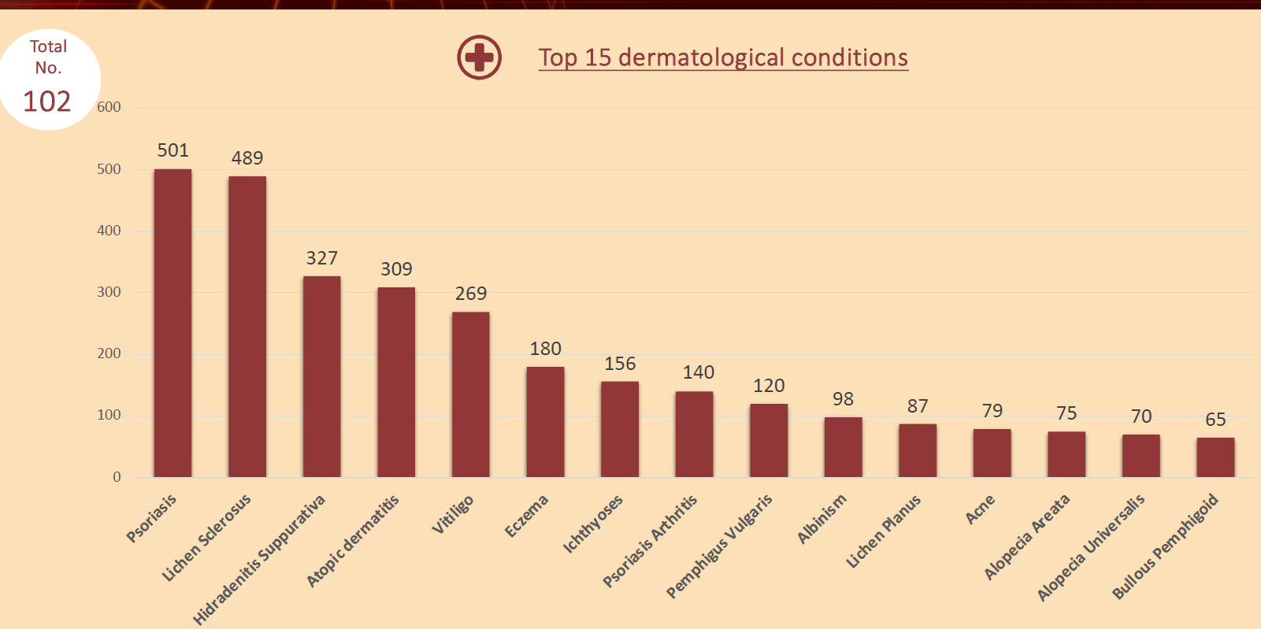
Initial Data
Phase 6
Confidential
Evidence-Based
Advocacy

Slide 11
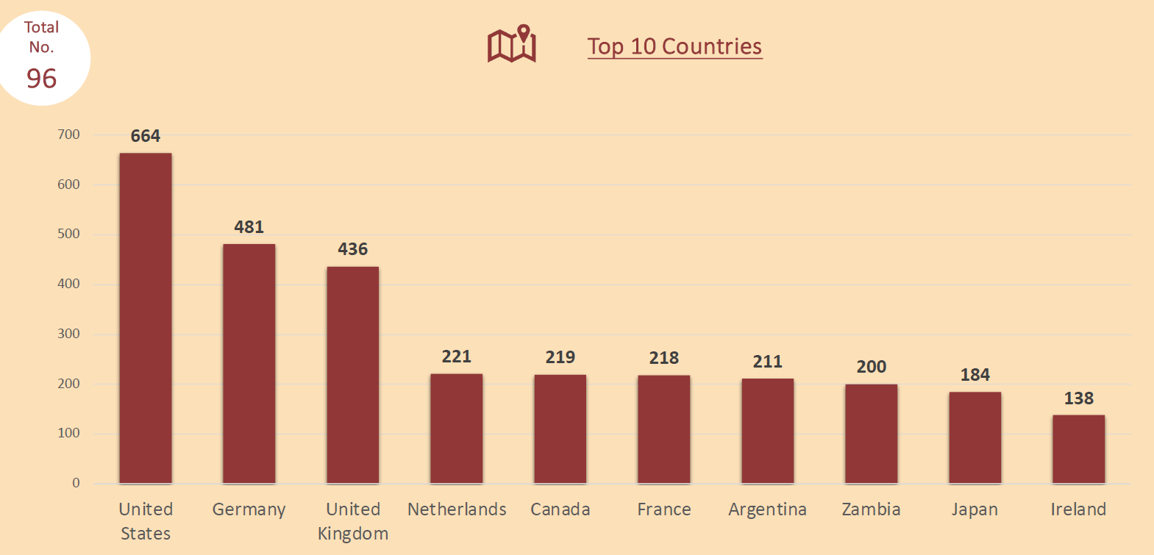
Initial Data
Confidential
Phase 6
Ireland | 138
Vietnam | 93
Australia | 91
Kenya | 76
Denmark | 71
Switzerland | 62
Chile | 58
Nepal | 49
Tanzania | 43
Colombia | 41
Philippines | 38
Belgium | 36
Spain | 32
Brazil | 31
Italy | 30
South Africa | 24
Peru | 23
Serbia | 22
India | 20
New Zealand | 20
Austria | 17
Portugal | 11
Congo (DRC) | 10
Nigeria | 10
Sri Lanka | 10
Evidence-Based
Advocacy

Slide 12
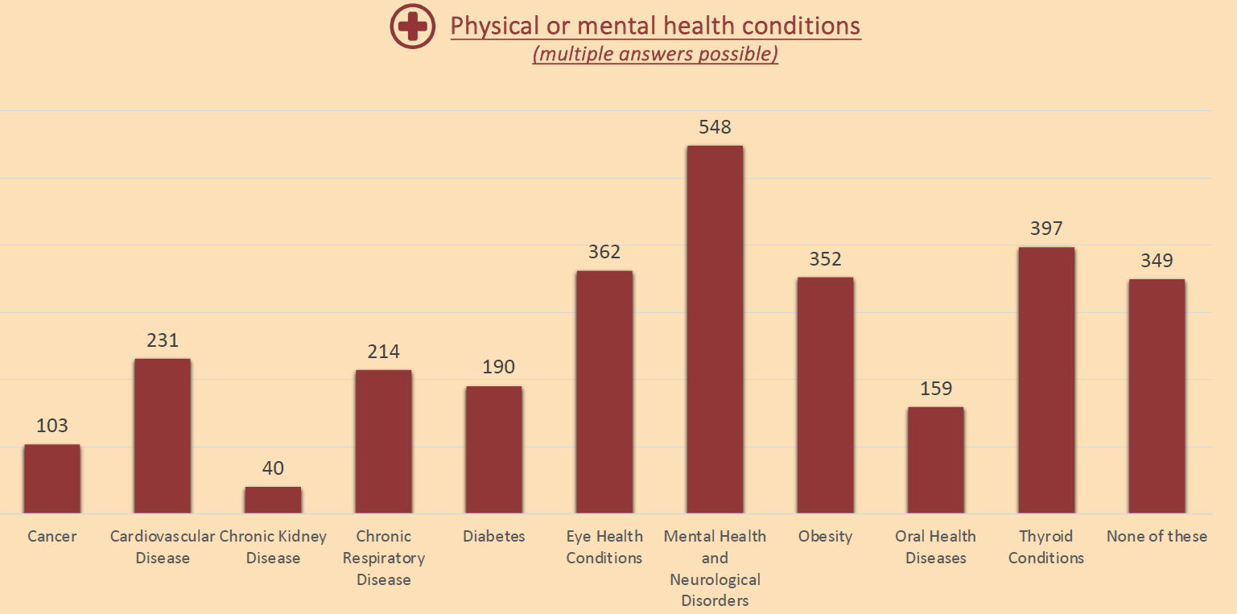
Initial Data
Confidential
Phase 6
Evidence-Based
Advocacy

Slide 13
GRIDD Study Variables – for impact analysis
Phase 6
Explicit variable | Question
Answer ID | Answer ID
Date Answered | Date Answered/Survey Started on
Date of Confirmation | Date of Confirmation/Survey Confirmed on
Subject | Subject ID
pridd - ID | PRIDD ID (for PDFs)
Language | Language (in which the survey is filled out)
age | 1. Age
sex | 2. What is your biological sex?
gender | 3. What gender do you identify with?
dermatological condition | 4. Which dermatological condition(s) do you have?
number of conditions | Internal - Number of conditions
other dermatological condition
ethnic origin | other:
country | In which country do you currently live?
Living area | 7. Which of the options best describes the area you live in?
Native language | 8. What is your native/first language? Other:
Education, highest | 9. What is your highest educational qualification?
Years lived with skin condition | 1. How many years have you lived with your condition?
Year of diagnosis | 2. In which year were you diagnosed with your condition?
Skin condition in family | 3. Do any of your family members have the same dermatological condition (as the one you identified as most impactful)?
How many family members | 3b. If yes, how many?
Other condition | 4. Aside from your dermatological condition(s), do you have any other physical or mental health conditions?
 | 4b. If yes_Cancer
 | 4b. If yes_Cardiovascular Disease
 | 4b. If yes_Chronic Kidney Disease
 | 4b. If yes_Chronic Respiratory Disease
 | 4b. If yes_Diabetes
 | 4b. If yes_Eye Health Conditions
 | 4b. If yes_Mental Health and Neurological Disorders
 | 4b. If yes_Obesity
 | 4b. If yes_Oral Health Diseases
 | 4b. If yes_Thyroid Conditions
 | 4b. If yes_None of these
Descriptive
Confidential
Evidence-Based
Advocacy

Slide 14
Variables
Phase 6
Confidential
Patient Organization
Explicit variable | Question
Member of patient organisation | 7. Are you a member of a patient organisation?
Name of patient organisation | 7b. If yes, what is the name of the patient organisation?
Explicit variable | Question
Health care spendings per month | 1. Approximately how much do you spend on managing your dermatological condition each month (e.g. on medical appointments, prescriptions, over the counter products, cleaning expenses)?_ Value
Earnings per month | 2. How much do you earn each month?_Value
GP visits 12 months | 3. How many times have you visited a GP about your dermatological condition over the last 12 months?
Derm visits 12 months | 4. How many times have you visited a dermatologist about your dermatological condition over the last 12 months?
Satisfaction with health care | 5. How satisfied are you with the current healthcare you are receiving for your dermatological condition?
Use of prescribed treatments | 6. Are you currently using treatments prescribed by a healthcare professional for your dermatological condition?
Effectiveness of treatments | 6b. If yes, how effective do you think this treatment is?
Visit of other professionals | 7. Have you visited any other professionals (e.g. herbalist) about your dermatological condition over the last 12 months?
Helping persons for filling survey | The survey questions were read to me by another person who helped me to record and submit my responses.
Economic and
Health Care
Evidence-Based
Advocacy

Slide 15
Variables
Phase 6
Confidential
Skin
Explicit variable | Question
Skin type | 5. Fitzpatrick skin type
Body map: affected areas | 6. Body map
Explicit variable | Question
PRIDD 1-16 items | 1-16 items
DLQI 1-10 items | 1-10 items
EQ-5D 1-5 items | 1-5 items
EQ-VAS | VAS
WHO-5 1-5 items | 1-5 items
PHQ-10 | 1-10 items
GAD-7 | 1-7 items
PGA1 - Bad skin condition | 1. How bad has your dermatological condition been over the last month?
PGA2 - difficulty caused | 2. How much difficulty has your dermatological condition caused overall over the last month?
Other measures
Evidence-Based
Advocacy

Slide 16

Questions?
Notes:
Jennifer

