Slide 1





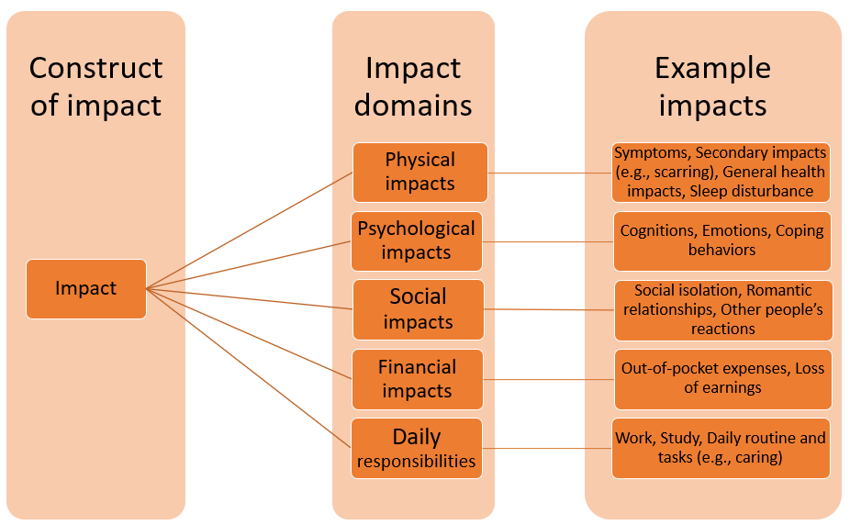

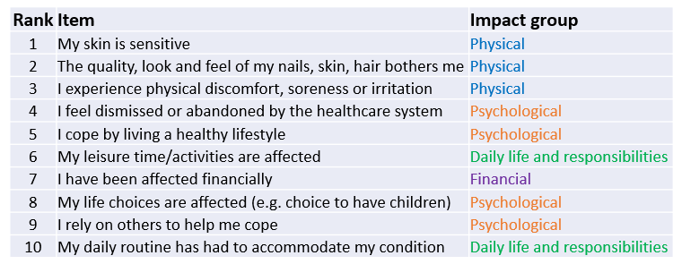
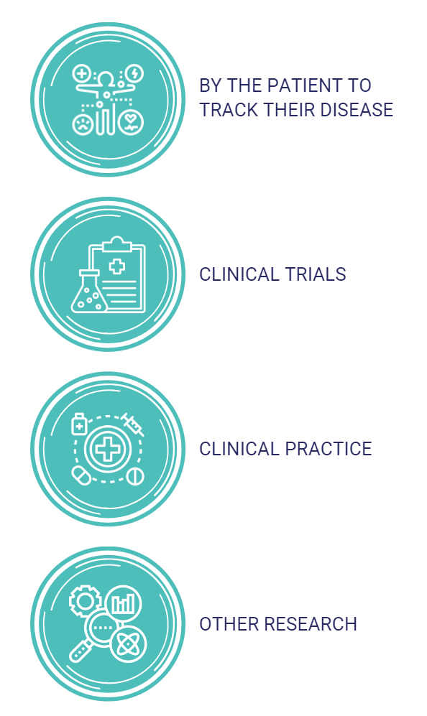
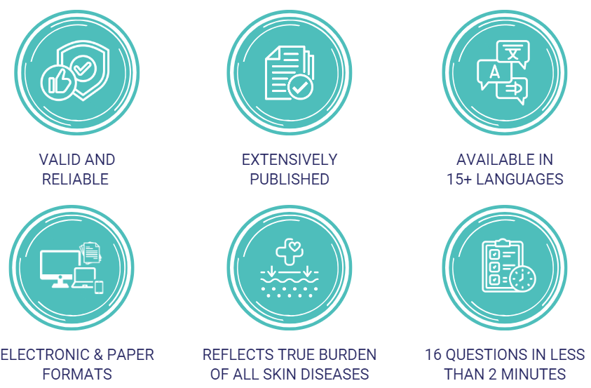


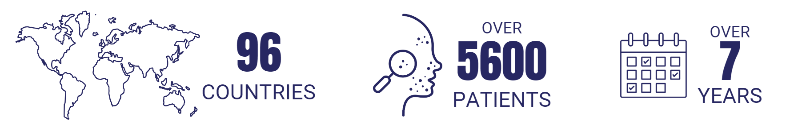

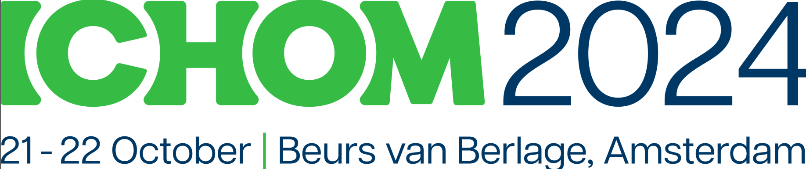
Patient-Reported Impact of Dermatological Diseases (PRIDD) measure
Allison Fitzgerald¹, Nirohshah Trialonis-Suthakharan², Rachael Pattinson³, Jennifer Austin¹, Christine Bundy⁴, Matthias Augustin²
¹International Alliance of Dermatology Patient Organizations, Ottawa, Canada, ²University Medical Center Hamburg-Eppendorf, Germany. ³School of Dentistry, Cardiff University, UK. ⁴School of Healthcare Sciences, Cardiff University, UK .
BACKGROUND
The Global Research on the Impact of Dermatological Diseases (GRIDD) project has developed the Patient-Reported Impact of Dermatological Diseases (PRIDD), a new measure of the impact and burden of dermatological conditions on the patient’s life..
Target population
Adults (≥ 18 years) worldwide living with a dermatological condition
Target construct
Impact of dermatological conditions on the patient’s life
Application
Research and clinical practice
PRIDD RESULts iii - Psychometric testing
Survey 1
504 participants; 35 conditions; 38 countries | Rasch analysis, structural validity, internal consistency, construct validity, floor and ceiling effects
Survey 2
272 participants; 27 conditions; 26 countries | Test-retest reliability, measurement error, responsiveness, Minimally Important Change (MIC)
2-4 week interval
Systematic Review
PROM​ | CONTENT VALIDITY​ | STRUCTURAL VALIDITY​ | INTERNAL CONSISTENCY​ | RELIABILITY​ | MEASUREMENT ERROR​ | CONSTRUCT VALIDITY​ | RESPONSIVENESS​ | RECOMMEND-ATION​
DLQI​ | W​ | ???​ | +++​ | ?​ | ​ | +++​ | +++​ | B​
PRIDD​ | ​++ | +++ ​ | ​+++ | +++ ​ | ​? | ​+++ | ? ​ | A​
Skindex​ | W​ | ???​ | W​ | W​ | ​ | -​ | W​ | B​
Skindex 29 | W​ | ???​ | +++​ | W​ | ​ | +++​ | W​ | B​
Skindex 16​ | W​ | ++​ | ++​ | ​ | ​ | +​ | W​ | B​
COnsensus-based Standards for Selection of health Measurement INstruments
None of the existing 36 dermatology PROMs met the scientific standards.
PRIDD Results I – Qualitative Patient Interview studies
W = weak evidence; + = sufficient evidence; - = insufficient evidence; ? = indeterminate evidence
A= Recommended for use
B=Potential to be recommended for use, but they require further research
C= Should not be recommended for use
263 unique shared impacts of dermatological conditions were found, falling into five broad groups: physical, psychological, social, financial, and daily life and responsibilities impacts. We started drafting PRIDD using these 263 impacts and the conceptual framework shown here.
Real world evidence is needed to determine minimally important change and responsiveness.
Patient ENGAGEMENT in Measure development
Item Gathering: 2019-2020
Workshop: 37 patients in 16 countries and 14 diseases
Patient interviews: 28 patients in 11 countries and 5 diseases
Delphi Surveys: 2020-2021
1154 patients in 61 countries and 90 diseases
Cognitive Interviews: 2021
12 patients in 4 countries and 6 diseases
Survey #1: 486 patients (Completed Dec. 2021)
Psychometrics Surveys: 2021-2022
Survey #2: Test - 504 patients completed July 2022; re-test – 272+ patients (Completed Sept. 2022)
Outcome: 263 items
Outcome: 27 items
Outcome: 26 items
Outcome: 16 items
263 shared impacts
PRIDD RESULTS ii - Global Delphi Survey and cognitive interviews
PRIDD MEasure
Patients prioritised 27 impact items for inclusion in the first draft of PRIDD. The list of the top 10 impacts can inform research questions and initiatives that are of most important to patients.
This multidimensional measure is valid, reliable and ready for use with adult patients across all dermatological conditions. It assesses four areas of impact: physical, life responsibilities, psychological and social.
Two Delphi rounds
Six languages
Quantitative data, Qualitative data
The first draft was pilot-tested with 12 patients, representing 6 dermatological conditions and 4 countries. It produced a 26-item version of PRIDD with evidence of content validity, feasibility, and acceptability from patients.
Download the app
Implication for patient use: PRIDD highlights the need for holistic support addressing psychological, physical, and lifestyle factors in dermatology care. PRIDD can be used in partnership with patients to better understand patient suffering – by the patient to track their disease; in clinical practice; in clinical trials; and in other research.
Implications for research: GRIDD produced a novel (and repeatable) methodology for developing patient-relevant outcome measures (or PROMS) that be used across disease areas.
discussion
PRIDD is the only validated dermatology impact measure applicable to all skin conditions. It is the first PROM in dermatology to be developed and validated in partnership with patients.
Allison FitzGerald
GlobalSkin
Check out our
publications
For more information, please visit the
website: www.globalskin.org

