Slide 1




Psychometric testing of the Patient-Reported Impact of Dermatological Diseases (PRIDD) measure
Dr Rachael Pattinson
Lecturer in Psychology, Cardiff University
On behalf of the GRIDD team
Notes:
Hi. I’m Dr Rachael Pattinson. A health psychologist and lecturer in psychology at Cardiff University
I’m presenting on the psychometric testing of the new Patient-Reported Impact of Dermatological Diseases (PRIDD) measure on behalf of the Global Research on the Impact of Dermatological Diseases (GRIDD) team
The GRIDD project aims to collect global data on the impact of dermatological diseases and the PRIDD measure was developed to collect that data.
There are a number of QR codes to our journal articles and other outputs throughout the presentation, so feel free to get your phone out

Slide 2
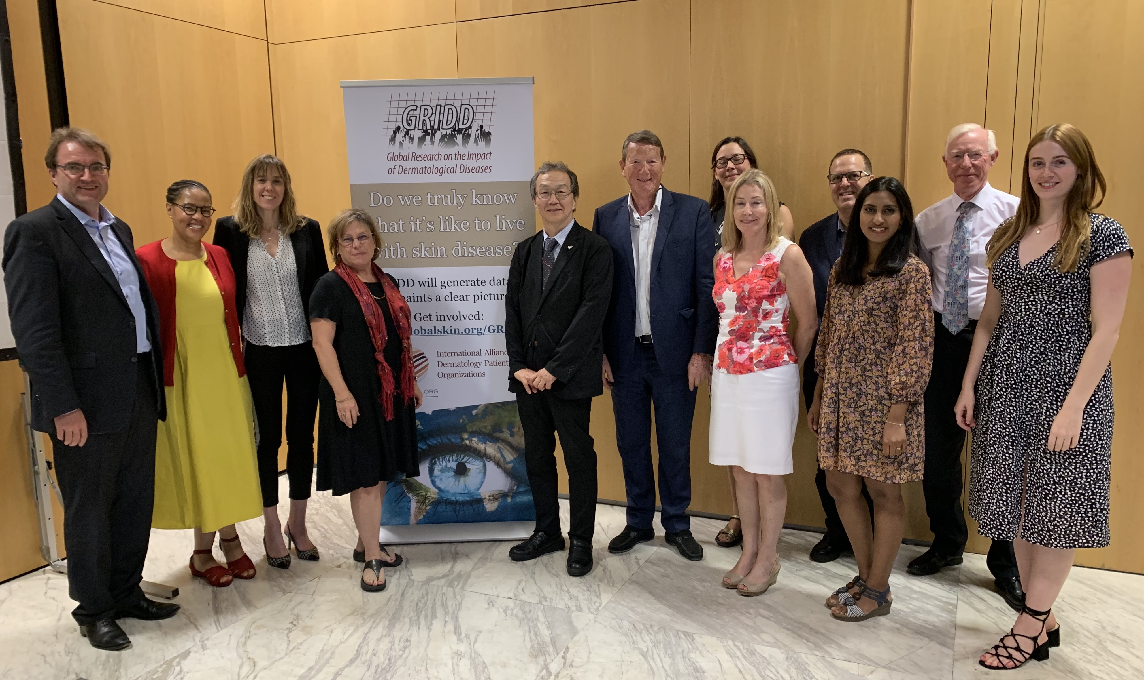




Global Research on the Impact of Dermatological Diseases (GRIDD) project
Jennifer Austin
CEO
Allison FitzGerald
Project Manager
Tammi Shipowick
Programs Director
Visnja Zaborski Breton
Public Affairs Director
Prof. Matthias Augustin
Co-lead Researcher
Nirohshah Trialonis-Suthakharan
Researcher
Prof. Chris Bundy
Co-lead Researcher
Dr. Rachael Pattinson
Researcher
Notes:
The GRIDD project is funded by GlobalSkin, an international alliance of over 200 dermatology patient organisations representing over 60 diseases and countries, and is an international collaboration between patient organisations and multidisciplinary research teams at Cardiff University and University Medical Centre Hamburg-Eppendorf.

Slide 3
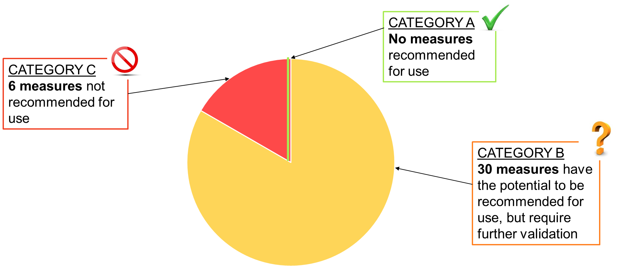
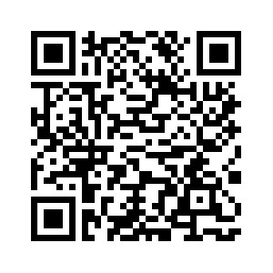
The Patient-Reported Impact of Dermatological Diseases (PRIDD) measure
Study 1
Target population
Adults (≥ 18 years) worldwide living with a dermatological condition
Target construct
Impact of dermatological conditions on the patient’s life
Application
Research and clinical practice
Notes:
My colleague presented an overview of the development and validation of the new PRIDD measure earlier, so I won’t go into much detail into that.
I however do want to recap some main points.
Clinicians, researchers and regulators such as the FDA select PROMs based on their quality.
Our systematic review of all the existing dermatology-specific PROMs (so PROMs that can be used across conditions) found that none of the existing 36 measures could be recommended for use according to the standardised COSMIN criteria.
This included widely used PROMs like the DLQI and Skindex.
This was largely due to insufficient patient involvement in development and a reliance on classical over modern psychometric methods.
We therefore developed PRIDD in close collaboration with patients to comprehensively measure the impact of dermatological conditions on patients’ lives. It is designed for use with adults with any dermatological condition worldwide.

Slide 4
Patient Inclusion in PRIDD development: 2490+ patients
Study 1
Item gathering (Qualitative interviews): 2019-2020
Workshop: 37 patients in 16 countries and 14 diseases
Patient interviews: 28 patients in 11 countries and 5 diseases
Delphi study (2 rounds): 2020-2021
1154 patients in 61 countries and 90 diseases
Cognitive Interviews: 2021
12 patients in 4 countries and 6 diseases
504 patients in 38 countries and 35 diseases
Field testing study: 2021
Outcome: 263 items
Outcome: 27 items (5 domains)
Outcome: 26 items (5 domains)
Outcome: 16 items (4 domains)
Systematic review: 2018-2019
36 dermatology PROMs identified
COSMIN methodology for systematically reviewing patient-reported outcome measures (PROMs)
None met COSMIN standards to be recommended for use
Think aloud and probing methods
Psychometric testing: 2022
Factor analysis and Rasch analysis
486 patients in 42 countries and 50 diseases
Outcome: 24 items (5 domains)
6 measurement properties tested. Interpretability information – floor and ceiling effects, score banding & Minimally Important Change
Study 2
Study 3
Study 4
Study 5
Study 6
Notes:
There have been many phases in PRIDD’s development since we started in 2018.
My colleague presented on studies 1-4, I'm focusing here on the psychometric testing studies. Studies 5 and 6.

Slide 5
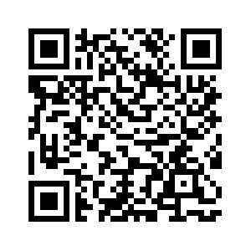
Conceptual framework of the impact of dermatological conditions
Study 2 - 4
Impact
Physical impacts
Symptoms, Secondary impacts (e.g. scarring), General health impacts, Sleep disturbance
Psychological impacts
Cognitions, Emotions, Coping behaviors
Impact domains
Example impacts
Social impacts
Financial impacts
Construct of impact
Social isolation, Romantic relationships, Other people’s reactions
Daily responsibilities
Out-of-pocket expenses, Loss of earnings
Work, Study, Daily routine and tasks (e.g. caring)
263 shared impacts
263 items, 5 domains → 26 items, 5 domains
Notes:
We started off developing PRIDD by conducting semi-structured interviews with 65 people individually and in small groups from around the world to understand how their dermatological condition affected them.
Thematic analysis of those data identified 263 reported impacts that cut across dermatological conditions and geographical regions.
These shared impacts fell into five broad groups: physical, psychological, social, financial and daily life and responsibilities impacts.
Together, these groups form the conceptual framework of impact shown here.
We refined this through our global Delphi study of over 1,000 patients and pilot testing.
Together, these studies produced a version of PRIDD with 26-items across these 5 domains

Slide 6
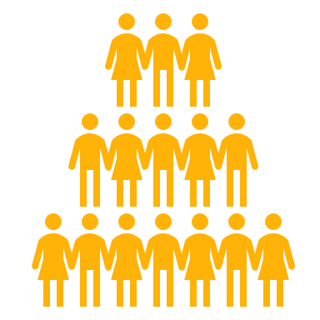

Field test study
Study 5
Aim: To examine the factor structure of PRIDD and determine the definitive selection of items for each subscale through modern psychometric methods.
Data: Demographics and PRIDD. Data analysis: Confirmatory factor analysis, exploratory factor analysis. Rasch analysis including Differential Item Functioning (DIF) for age, gender, disease, native English and educational attainment.
483 participants
42 countries
Notes:
Next, we performed two rounds of psychometric testing.
In the first round, we conducted a cross-sectional survey of 483 participants and used factor analyses and Rasch analysis to determine the final set of domains and items.

Slide 7
Field testing: Results
Study 5
Impact
Physical Impact
Physical discomfort, sleep disturbance, fatigue, general health
Life Responsibilities
Treatment problems, leisure, everyday choices, extra expenses, independence
Impact domains
Psychological Impact
Social Impact
Construct of impact
Anxiety, depression, hypervigilance
Relationships with close ones, social life and interactions, sexual intimacy, ability to perform social roles
Item concepts
16 items,
4 domains
Notes:
The original 5-domain conceptual framework was not supported by a confirmatory factor analysis. An exploratory factor analysis suggested that the financial impact domain and daily life and responsibilities domain should be combined.
A Rasch analysis supported each of the resulting four domains and items that misfit the Rasch model were removed.
This resulted in the final 16-item PRIDD with 4 domains.

Slide 8
Psychometric testing
Study 6
Aim: To finalise PRIDD, test its measurement properties and interpretability information.
Survey 1
504 participants; 35 conditions; 38 countries
Structural validity, internal consistency; construct validity
Survey 2
272 participants; 27 conditions; 26 countries
Test-retest validity; measurement error; responsiveness
2–4 weeks
Notes:
Finally, we conducted a longitudinal survey of 504 participants with two time points 2-4 weeks apart to test 6 measurement properties: structural validity, internal consistency, construct validity, test-retest reliability, measurement error and responsiveness.
We also sought to establish the interpretability information including floor and ceiling effects, score bandings, and MIC.
We used COSMIN’s standardised criteria to test each of these measurement properties, so PRIDD was tested in the same way as the measures in our systematic review were.

Slide 9


Measurement property |  | Requirement | Rating | Results
Structural validity | Unidimensionality | - No violation of unidimensionality - No violation of local independence - Adequate model fit: 2 >0.01 | + | PRIDD and all subscales unidimensional with no local dependency. χ2 = 0.11
 | Structural validity | CFI or TLI or comparable measure >0.95 OR RMSEA <0.06 OR SRMR <0.08 | + | CFI = 0.96; TLF = 0.97; RMSEA = 0.09; SRMR = 0.03
Internal consistency |  | Person Separation Index ≥ 0.7 | + | Person Separation Index = 0.89
Hypothesis testing for construct validity |  | 75% of hypotheses met | + | 76% of hypotheses met
Test-retest reliability |  | ICC or weighted Kappa ≥ 0.70 | + | ICC = 0.93
Measurement error |  | SDC or LoA < MIC | + | LoA = 1.30 < MIC = 4.14
Responsiveness |  | The result is in accordance with the hypothesis OR AUC ≥ 0.70 | - | 0 hypotheses met
Study 6
“+” = sufficient
” –“ = insufficient
“?” = indeterminate
Notes:
In COSMIN terminology, we found ‘very good’ evidence for a sufficient rating – the highest possible score – for structural validity, internal consistency, construct validity, test-retest reliability and measurement error.
We were unable to establish the MIC as the anchor was not sufficiently correlated to be used.
Responsiveness was insufficient. These also relied on the same anchor, so we will be retesting these properties in our current study.

Slide 10
Psychometric testing: Comparison of Measures
PROM​ | Content validity​ | Structural validity​ | Internal consistency​ | Reliability​ | Measurement error​ | Construct validity​ | Responsiveness​ | Recommendation​
DLQI​ | W​ | ???​ | +++​ | ?​ | ​ | +++​ | +++​ | B​
PRIDD​ | ​++ | +++ ​ | ​+++ | +++ ​ | ​+++ | ​+++ | ? ​ | A​
Skindex​ | W​ | ???​ | W​ | W​ | ​ | -​ | W​ | B​
Skindex 29 | W​ | ???​ | +++​ | W​ | ​ | +++​ | W​ | B​
Skindex 16​ | W​ | ++​ | ++​ | ​ | ​ | +​ | W​ | B​
W = weak evidence; + = sufficient evidence; - = insufficient evidence; ? = indeterminate evidence
A = Recommended for use
B = Potential to be recommended for use, but they require further research
C = Should not be recommended for use
Notes:
This slide shows an overview of the measurement properties of PRIDD and the most commonly used dermatology PROMs evaluated in our systematic review – the DLQI and Skindex measures.
We can see that PRIDD is the only dermatology PROM that can be recommended for use, according to the COSMIN criteria
That’s even accounting for that inconclusive responsiveness result.

Slide 11
PROMs should be developed with sufficient patient involvement and using classic & modern psychometric methods
PRIDD is the only dermatology-specific PROM that can be recommended for use according to the COSMIN critieria
GRIDD study now collecting data from 10,000+ patients using PRIDD – 16 languages & further psychometric testing
Notes:
PROMs play a key role in research and clinical practice. For this reason, they should be of the highest quality.
PRIDD is the first dermatology-specific PROM that meets the COSMIN criteria to be recommended for use.
High levels of patient involvement along with using modern psychometric methods were key to achieving this.
We have since translated PRIDD into 15 languages using forward and back-translation methods

Slide 12
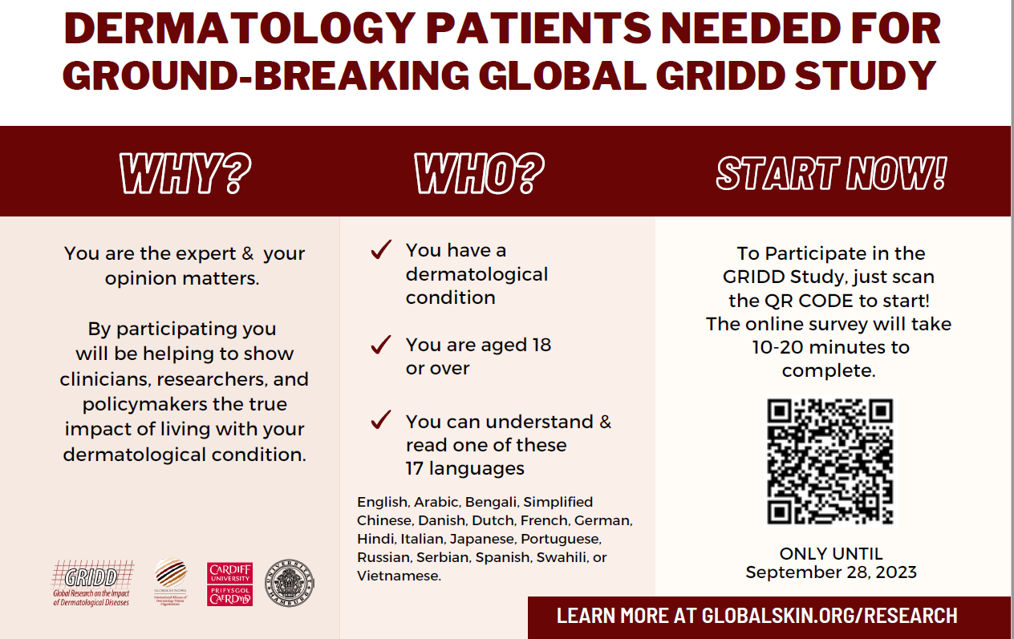
Notes:
We can now use the PRIDD measure in the real-world and have launched the GRIDD study to collect that global data on the impact of dermatological conditions using PRIDD.
Along with estimating the burden of disease, we will be testing the psychometric properties all the language versions and establishing the MIC.

Slide 13
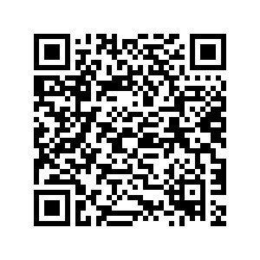

THANKS!
Do you have any questions?
pattinsonr@cardiff.ac.uk
GRIDD overview & outputs
Share or take part in the GRIDD study
Notes:
Thank you for listening to this presentation.
You can find out more about the GRIDD project by scanning the QR on the screen.
Our GRIDD study is live and we are aiming to recruit at least 10,000 patients worldwide. Please use the QR code on the right to share or take part in the study

