Slide 1
LEVERAGING THE WORLD HEALTH ASSEMBLY
RESOLUTION ON SKIN DISEASES
ADVOCACY toolKIT

Slide 2
About
this Toolkit

Slide 3
Turning a global commitment
into national action
In 2025, the World Health Assembly adopted a Resolution recognising skin diseases as a global health priority.
The Resolution calls for concrete national action, including:
strengthening training for healthcare professionals in primary care
expanding the use of digital technologies
integrating skin diseases into wider health policies
investing in research and innovation
improving data collection and surveillance.
By adopting the Resolution, national governments have already agreed to act. Skin disease advocates now have a unique opportunity to drive policy change and improve care for millions of people.
The World Skin Health Coalition and its partners were proud to support the adoption of the Resolution, which represents an overdue recognition of the immense burden that skin diseases place on individuals, communities and health systems. We are now working to support its implementation through a range of educational and advocacy activities, including this toolkit.
3

Slide 4

What is
this toolkit for?
Aims
This toolkit has been developed for patient organisations, healthcare professionals and industry partners to leverage the Resolution on skin diseases and drive meaningful change in policy and practice.
It summarises the materials that have been developed for this purpose and provides further guidance and tools for engaging with policymakers and other stakeholders. It also includes case studies that demonstrate the feasibility and potential impact of implementing many of the Resolution’s policy asks.
How to use it
The toolkit can be used for reference or to guide internal training and discussions on policy engagement. Selected slides can also be copied or adapted and shared directly with policymakers.

Slide 5
Supporting
materials
This toolkit aligns with a set of supporting materials that can be downloaded here.
Educational resources
Key messages documents tailored for use by healthcare professionals, patient advocates and industry partners
Policy analysis on links between the skin health Resolution and other recent global health policies
Case studies to inspire action in other countries
Communications materials
Infographic that can be used to advocate for implementation of the Resolution
Social media assets to raise awareness of the Resolution and its key messages
Template letter to support engagement with policymakers
5

Slide 6
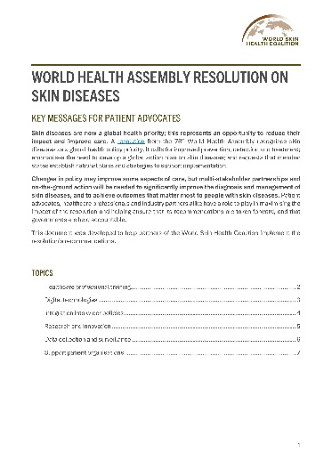
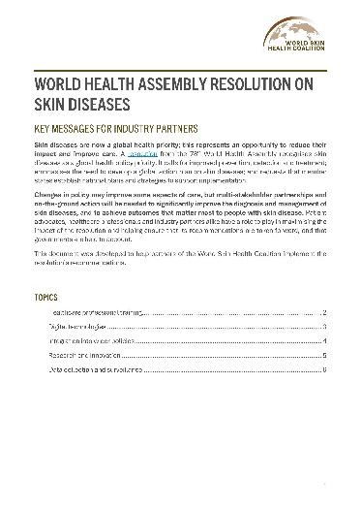
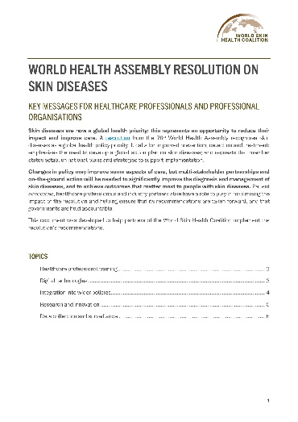
Key messages documents
Three tailored key messages documents are available for:
patient organisations and advocates
healthcare professionals and societies
industry partners.
They summarise priority recommendations from the Resolution and messaging that can be used by each stakeholder group to support implementation. Key messages documents can be shared within your organisation to help identify specific policy asks and develop your own advocacy and engagement materials.
The documents present recommendations and key messages across five priority topics:
healthcare professional training
digital technologies
integration into wider policies
research and innovation
data collection and surveillance.
The document tailored to patient advocates includes an additional topic on supporting patient organisations. Each topic includes policy recommendations, contextual information, stakeholder-specific actions and key messages.
6

Slide 7
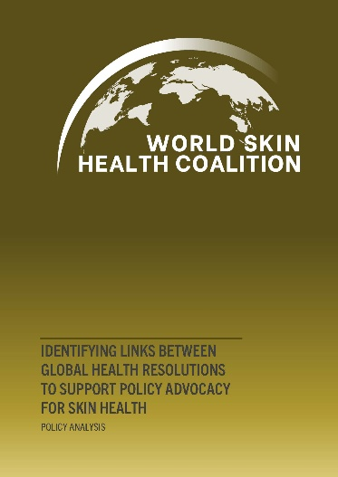
Policy analysis
The policy analysis presents areas of commonality between the skin diseases Resolution and four other recent global policy documents:
WHA Resolution on Rare Diseases
WHA Resolution on Lung Health
WHA Resolution on Social Participation
United Nations General Assembly declaration on non-communicable diseases (NCDs), mental health and wellbeing
There are many similarities in the challenges and recommendations identified in these documents, which can be leveraged in discussions with policymakers to demonstrate the widespread benefits of investing in services to improve care for skin diseases.
The analysis identified six common themes:
Primary care
Integration of healthcare policies and services
Digital services
Data and surveillance
Equity and inclusion
Environmental exposures
Each theme and its inclusion in the documents is summarised, and policy-focused messaging is included for use in skin disease advocacy.
7

Slide 8
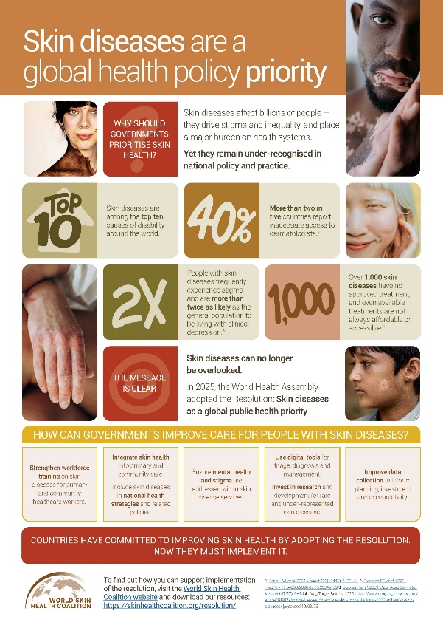
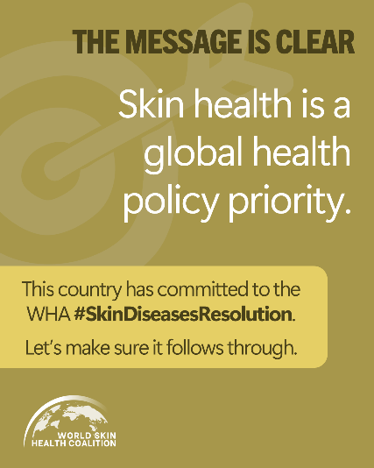
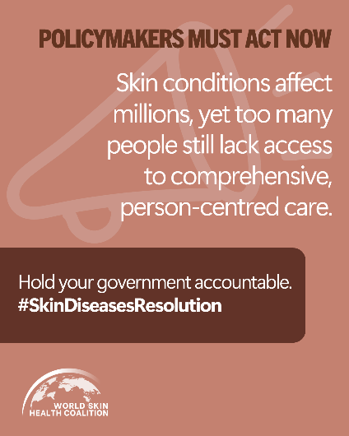
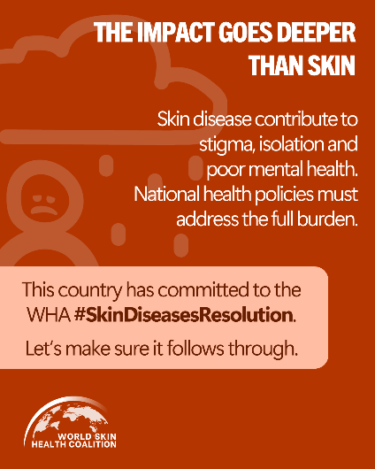
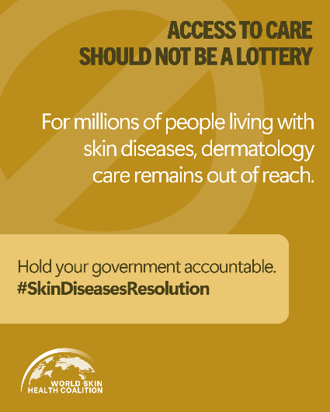
Communications materials
Infographic
The infographic presents globally relevant messages on the impact of skin diseases and the reasons for identifying them as a public health policy priority. It aligns with the key messages documents and includes the policy asks from the Resolution.
Social media assets
Three professionally designed, post-ready social media assets are available for you to share with your networks, for use across different social media platforms. These are accompanied by text for use that can be tailored to your organisation, your skin disease or condition and to your country or region.
8

Slide 9
Public open webinar
Tuesday, 8th September 2026, afternoon CET
The World Skin Health Coalition are hosting a
public webinar. The webinar aims to:
create a shared understanding of the significance of the Resolution, its key messages and plans for implementation
encourage participants to understand how they can support national-level implementation of the Resolution, including through the sharing of lessons and insights from speakers and panel members
provide an opportunity for participants to ask speakers and panel members questions about the Resolution and its implementation.
The webinar will be open to all partners, their networks and any contacts that may be interested such as local policy- and decision-makers. Further details of the webinar, including speakers and how to register, will be shared soon. We hope you will support us in sharing webinar registration details with our networks.
9

Slide 10
Policy Asks
from the
Resolution

Slide 11
The Resolution commits member states to act on skin diseases
Healthcare professional training and primary care integration
Strengthen dermatology training for primary care and community healthcare workers
Integrate dermatology into primary care services
Digital technologies
Implement digital tools to support efficient and accurate triage, diagnosis and management
Integrated policies and services
Integrate skin disease care into related policies, and ensure that mental health and stigma are addressed in skin disease services
Research and innovation for underserved and under-represented groups
Invest in research and development for rare and neglected skin diseases
Support an inclusive approach to research
and development
Data collection and surveillance
Support national or regional data collection on skin diseases and conditions, including rare skin diseases
It includes recommendations for national policymakers
to implement service- and system-level
change throughout
the health system.
Evidence points and guidance on how to support implementation
of these policy asks can be found in the key messages documents.
11

Slide 12
Leveraging
the Resolution
in National Policy
Engagement

Slide 13
Direct engagement with policymakers
to drive action
Actions: Request in-person meetings, organise a policy roundtable, speak with local policymakers at public events
Aim: To secure a commitment to policy action that supports the implementation of the Resolution’s recommendations
Approach: Reference the Resolution as policy that has already been approved by the government and frame the discussion around implementation. Present clear, actionable policy asks and highlight links with other health system priorities when possible
Available resources: Template policy outreach letter, infographic, key messages document, policy analysis
13

Slide 14
Template policy outreach letter
Dear [Name] [Surname],
I am writing to draw your attention the significant public health impact of skin diseases and to a recent global commitment that is directly relevant to national health priorities.
In 2025, World Health Organisation member states unanimously adopted the World Health Assembly Resolution on Skin Diseases (WHA78.15). This landmark Resolution formally recognises skin diseases as a global public health priority and commits governments to strengthen prevention, early diagnosis, treatment, long‑term care and data collection.
Skin diseases affect millions of people worldwide, putting huge pressure on primary care, and are associated with long‑term disability, mental health challenges, stigma and reduced quality of life. Despite this, skin diseases have received limited policy attention. Services are inconsistent, creating inequalities in access to care. Improved skin health contributes to more efficient health services, improved mental health outcomes and more equitable access to care.
Implementation of the Resolution’s recommendations in [country] will be essential to translate this global commitment into meaningful benefits for people and the health system. In your role as [role] responsible for [responsibility], you are well positioned to [e.g. raise awareness of this issue; convene officials to drive support; supporting implementation]. We would welcome the opportunity to meet with you or your team to [e.g. discuss how the Resolution can support national priorities; identify practical opportunities for implementation; explore areas for collaboration; identify priority actions; identify alignment with existing strategies].
Thank you for your attention to this important matter. I look forward to your response.
Yours sincerely,
[Name Surname]
[Role]
[Organisation]
This template letter
can be used to initiate
contact with policymakers.
It should be tailored to
the priorities of the
stakeholder and the
local context.
A Word version of this template is available in English, French and Spanish here.
14

Slide 15
Actions: Post on social media and organisation websites, deliver a
public awareness campaign, share communications materials with
policymakers and the public
Aim: To build awareness, momentum and public accountability
Approach: Use the Resolution to demonstrate that skin
diseases are a recognised health priority. Align awareness
campaigns with key messages and policy asks from
the Resolution and highlight links to broader
messaging around equity and mental health
Available resources: Infographic, social
media assets, key messages documents
•
•
•
Communications strategies to raise awareness and create momentum for change
•
15

Slide 16
Case Studies

Slide 17
Australia
What happened
To address high rates of skin cancer, the Cancer Council collaborated with policymakers to launch the SunSmart advocacy and prevention initiative. It combined behavioural messaging ('slip, slop, slap')
with policy action and guidelines. For example, schools, workplaces and sporting organisations were encouraged to adopt sun protection policies and environmental strategies, such as shade provision.
They also campaigned for stronger regulation of artificial ultraviolet (UV) exposure, such as tanning beds.
What was achieved
The ongoing SunSmart campaign has contributed to change in public attitudes towards tanning, and is thought to have prevented over 100,000 skin cancers in the state of Victoria between 1988 and 2003.¹ In Western Australia, an estimated AUS $8.70 will be gained for every dollar spent on the campaign over the next 20 years.² It has also supported the introduction of national legislation banning tanning beds.
What we can learn
Advocacy for common skin conditions can be highly effective when it moves beyond awareness‑raising
to institutional and regulatory change. Embedding prevention into everyday settings, such as schools and workplaces — and framing skin health as a shared public health responsibility — can deliver large‑scale, long‑term impact. Evidence generation and economic analysis are powerful tools for sustaining
political commitment.
A long-term advocacy
and awareness campaign supported sustained sun protection policy and behaviour change
References
Shih ST-F, Carter R, Sinclair C, et al. 2009. Prev Med 49(5): 449-53
Collins LG, Minto C, Ledger M, et al. 2024. Health Promot Int 39(4)
17

Slide 18
Spain
What happened
Following the introduction of telemedicine more broadly, various regions of Spain introduced teledermatology services. These enable family physicians in primary care to submit clinical information and digital images of skin conditions to dermatologists for remote assessment. A study evaluated the first two years of implementation in one health area (Salamanca).
What was achieved
Over the two‑year period, more than 25,000 dermatology consultations were recorded, including over 4,500 non-face-to-face teledermatology consultations. Teledermatology consultations substantially reduced wait times from an average of almost two months (for conventional referrals) to an average of two days.
Nearly half of teledermatology cases were resolved without the need for in‑person specialist appointments, and the evaluation suggested that the teledermatology assessments more often met quality standards.
The service was particularly effective in improving access to dermatology expertise for people living in
rural areas.
What we can learn
Integrating teledermatology into routine primary care can significantly improve access to specialist dermatology expertise, shorten wait times, and enable a substantial proportion of skin conditions to be managed without face‑to‑face referral. Embedding digital consultation pathways into public health systems supports more efficient use of specialist resources while strengthening the role of primary care in managing common skin diseases.
Teledermatology reduced wait times and improved access to specialist care
Reference
Sánchez-Martín E, Moreno-Sánchez I, Morán-Sánchez M, et al. 2024. BMC Prim Care 25(1): 227
18

Slide 19
Mali
What happened
In an 18-month feasibility study between 2015 and 2017, nurses and general physicians from health regions without access to dermatologists received training on the diagnosis and management of common skin diseases. They were also given access to a teledermatology platform and instructed to refer all cases beyond their training and competency by uploading photographs and a concise patient history. Referrals were evaluated by a dermatologist, who provided a diagnosis and treatment recommendations.
Before the study, some of the nurses involved in the study had never used a computer, only some clinics had internet access and none had access to a digital camera. The necessary equipment and training were provided as part of the study.
What was achieved
Healthcare professional training resulted in a significant decrease in the proportion of inconclusive dermatological diagnoses, from 54% in the six months before training to 12% in the six months after training.
Over the course of one year, 180 patients were reviewed via the teledermatology platform; 96% were diagnosed successfully and managed locally. In a few cases, a diagnosis could not be made because of poor photo quality, and a small number of patients required biopsy.
Interviews with a sample of healthcare workers and patients found a high level of satisfaction with the intervention. Patients in particular highly valued the service and the ability to receive care locally.
What we can learn
Simple, low-cost initiatives that incorporate targeted training and digital tools can significantly improve access to accurate diagnosis and care for a broad range of skin diseases. While limited IT infrastructure can present challenges in some settings, basic training and equipment can overcome perceived barriers to the digitalisation of care.
Primary care training
and teledermatology expanded access to dermatology care in rural and underserved areas
Reference
Faye O, Bagayoko CO, Dicko A, et al. 2018. Trop Med Infect Dis 3(3)
19

Slide 20
Case study
United
Kingdom
What happened
Growing evidence of the psychological burden associated with skin diseases led to the development of psychodermatology as a recognised area of clinical practice. Psychodermatology services are multidisciplinary models of care that integrate dermatology with psychological or psychiatric support for people whose skin conditions are associated with a significant mental health impact. It is usually delivered through specialist outpatient clinics embedded in dermatology departments in secondary care.
From the early 2000s onwards, a number of public hospitals introduced psychodermatology or joint dermatology–psychiatry clinics. In 2012, the British Association of Dermatologists formally recognised the importance of psychodermatology and published minimum standards and recommended models of care.¹
What was achieved
Published evaluations and case studies show that psychodermatology services can:² ³
improve the identification and management of psychological distress in people with skin disease
reduce repeated consultations and high use of unplanned services
generate significant cost savings – often thousands of pounds per patient per year – by addressing unmet psychological needs and reducing inefficiencies in care pathways.
What we can learn
Psychodermatology demonstrates how skin diseases can be addressed in person‑centred, integrated care models, aligning dermatology with mental health policy objectives and improving outcomes for individuals with complex needs.
The introduction of psychodermatology
services improved care
and reduced costs
References
Bewley A, Affleck A, Dundy C, et al. 2012. Working Party Report on Minimum Standards for Psychodermatology Services 2012.
Shah RB. 2018. Int J Womens Dermatol 4(1): 8-11
Roberts V, Chan J, Davies J, et al. 2022.
Skin Health Dis 2(4)
20

Slide 21
Japan
What happened
Japan established the Rare Disease Data Registry of Japan (RADDAR‑J) as a national platform to support registries for designated rare diseases, including rare skin diseases. RADDAR‑J was designed as a shared, flexible infrastructure that enables specialist research groups to develop and sustain disease‑specific registries using common national standards for consent, governance and data use.¹ Within this framework, a national research group was formed for rare and intractable skin diseases, coordinating work on conditions including epidermolysis bullosa, congenital ichthyoses, oculocutaneous albinism, pseudoxanthoma elasticum and generalised pustular psoriasis.¹
What was achieved
Through the use of national data analyses, Japan has generated reliable clinical and epidemiological evidence for rare skin diseases that had been poorly characterised due to fragmented, small data sets. Disease‑specific patient registries have been established for several rare skin conditions, and the resulting evidence is used to inform national clinical guidance and consensus recommendations.² These activities have increased the visibility of rare skin diseases in Japan’s rare disease policy framework and supported more structured approaches to specialist care and long‑term disease management.²
What we can learn
National shared registry infrastructure supports the collection of consistent, high-quality data on rare skin diseases more effectively than local registries. By maximising data collection and streamlining governance, information about people living with even ultra-rare skin diseases is more easily translated to clinical guidance and national policy.
A national registry infrastructure for rare
skin diseases maximised data collection for
clinical guidance
References
Furusawa Y, Yamaguchi I, Yagishita N, et al. 2019. Learn Health Syst 3(3): e10080
Akiyama M, Takeichi T, Ikeda S, et al. 2025. Keio J Med 74(1): 11-20
21

Slide 22
Website
https://skinhealthcoalition.org/
Email
info@skinhealthcoalition.org
Published June 2026

